Slide 1
INTRODUCTION TO DATA SCIENCE · FINAL PRESENTATION
Diabetes Risk Prediction
Predicting diabetes from 21 health indicators using supervised machine learning
GROUP
INSTRUCTOR
Ali Raza - 2540010
M. Ammar - 2540004
Taha Ali - 2540008
Sir Zaki
SEMESTER · DATE
Semester 2 · 2026
Notes:
Greet the audience. State project title, team and instructor. Keep brief — 30 seconds. Move to the next slide.

Slide 2
OUTLINE
What we will cover today
· 01 · Problem statement
· 02 · Dataset overview
· 03 · Target & features
· 04 · Project workflow
· 05 · Data cleaning
· 06 · Exploratory data analysis
· 07 · Correlation analysis
· 08 · Train / test split
· 09 · Why machine learning?
· 10 · 4 candidate ML models
· 11 · Model comparison
· 12 · Random Forest results
· 13 · Top diabetes risk factors
· 14 · Streamlit web app
· 15 · Limitations
· 16 · Conclusion & Q&A
Diabetes Risk Prediction · Intro to Data Science · Sem 2
2 / 17
Notes:
Walk through the outline in 30 seconds. Tell the audience the talk is structured as Problem → Data → Method → Results → Demo → Conclusion.

Slide 3
01 · WHY THIS MATTERS
The diabetes problem
■ Diabetes affects 1 in 11 adults worldwide (~537 million people).
■ Early detection drastically reduces complications and costs.
■ Many people are unaware they have prediabetes or diabetes.
■ Doctors need low-cost, fast screening tools.
■ Patient survey data is cheap to collect — no lab tests required.
GLOBAL IMPACT
537M
adults living with diabetes
Source: IDF Diabetes Atlas 2021
Diabetes Risk Prediction · Intro to Data Science · Sem 2
3 / 17
Notes:
Open with the human impact. 'Diabetes is not a small problem — 537 million adults have it.' This frames why our project matters. Don't dwell more than 1 minute.

Slide 4
02 · DATA
Dataset overview
■ Source: CDC Behavioral Risk Factor Surveillance System (BRFSS), 2015.
■ Collected through annual phone interviews across the United States.
■ Cleaned version published on Kaggle by Alex Teboul.
■ Pre-balanced 50 / 50 between diabetic and non-diabetic patients.
■ Each row = one patient · each column = one health indicator.
DATASET AT A GLANCE
Records
70,693 patients
Features
21 health indicators
Target
Diabetes_binary (0 / 1)
Balance
50 % / 50 %
Type
Tabular · structured
Task
Binary classification
Diabetes Risk Prediction · Intro to Data Science · Sem 2
4 / 17
Notes:
Explain WHERE the data came from. BRFSS is a real CDC survey — that's why our model is grounded in actual public-health data. Mention 70k+ rows as a strength.

Slide 5
03 · VARIABLES
Target and features
TARGET VARIABLE (y)
Diabetes_binary → 0 = No Diabetes · 1 = Diabetes / Prediabetes
21 FEATURES (X)
VITAL · CLINICAL
LIFESTYLE
SELF-REPORTED · DEMOGRAPHICS
· HighBP — high blood pressure
· HighChol — high cholesterol
· CholCheck — checked in 5 years
· BMI — Body Mass Index
· Stroke — ever had a stroke
· HeartDiseaseorAttack
· DiffWalk — difficulty walking
· Smoker
· PhysActivity
· Fruits
· Veggies
· HvyAlcoholConsump
· AnyHealthcare
· NoDocbcCost
· GenHlth — general health (1-5)
· MentHlth — bad-mood days
· PhysHlth — sick days
· Sex — 0 female / 1 male
· Age — group (1-13)
· Education — level (1-6)
· Income — bracket (1-8)
Diabetes Risk Prediction · Intro to Data Science · Sem 2
5 / 17
Notes:
Show that the target is binary — that's why we use classification. Then walk through the 3 categories of features quickly. Highlight BMI, HighBP, GenHlth — these become the top predictors later in the deck.

Slide 6
04 · METHOD
Project workflow
01
Data
Collection
02
Data
Cleaning
03
EDA &
Correlation
Load CSV
Duplicates · dtypes
Stats · heatmap
06
Insights &
App
05
Model
Evaluation
04
Model
Training
Top factors · GUI
Accuracy · matrix
Random Forest
Diabetes Risk Prediction · Intro to Data Science · Sem 2
6 / 17
Notes:
Walk through the 6 phases of CRISP-DM in 30 seconds. We collected real data, cleaned it, explored it, trained models, evaluated them, and built a web app.

Slide 7
05 · PREPROCESSING
Data cleaning — what we did
■ Checked for missing values → found 0 ✓
■ Removed duplicate rows → 1 636 dropped
■ Final shape: 69 057 rows × 22 columns
■ Converted 21 columns to int (everything except BMI which is float)
■ Verified class balance still ~50 / 50
BEFORE → AFTER
Rows
70 693 → 69 057
Duplicates
1 636 → 0
Missing values
0 → 0 ✓ already clean
Diabetes Risk Prediction · Intro to Data Science · Sem 2
7 / 17
Notes:
Key point: we dropped 1 636 duplicate rows. If we hadn't, the test set could have contained rows that the model already saw in training — inflating accuracy artificially. This is called 'data leakage' and is a viva-favourite question.

Slide 8
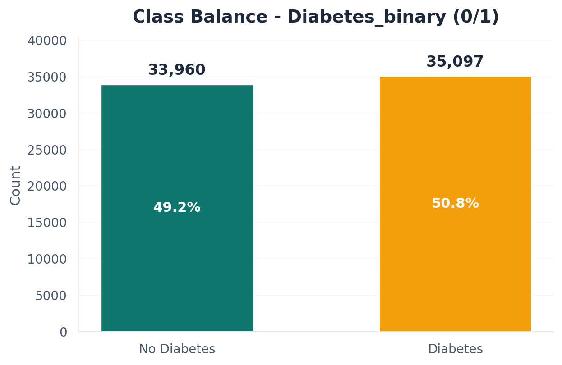
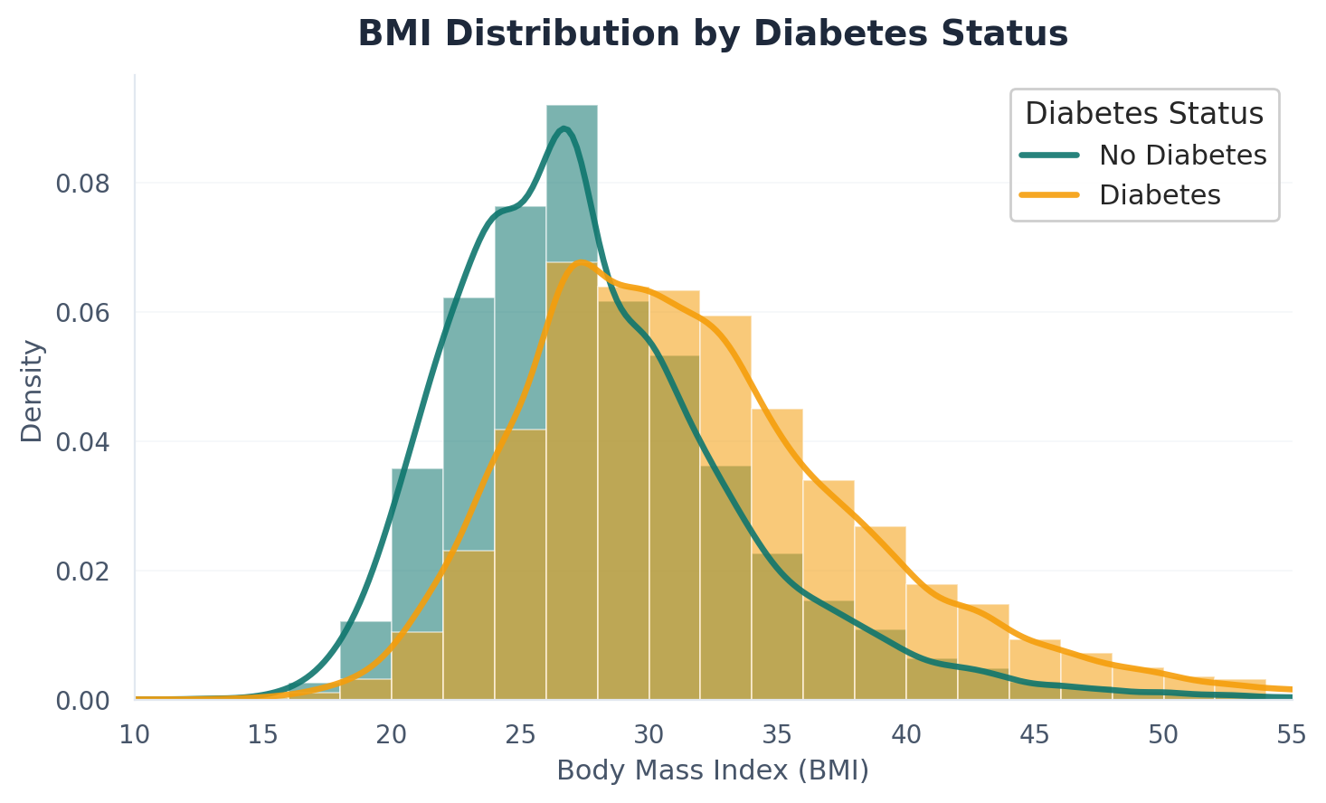
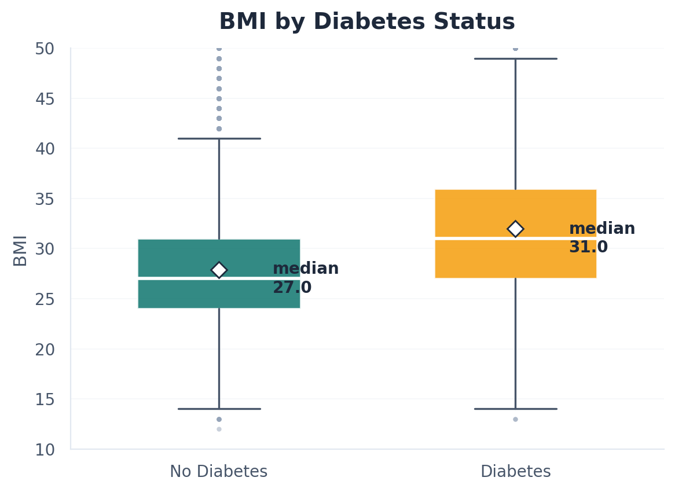
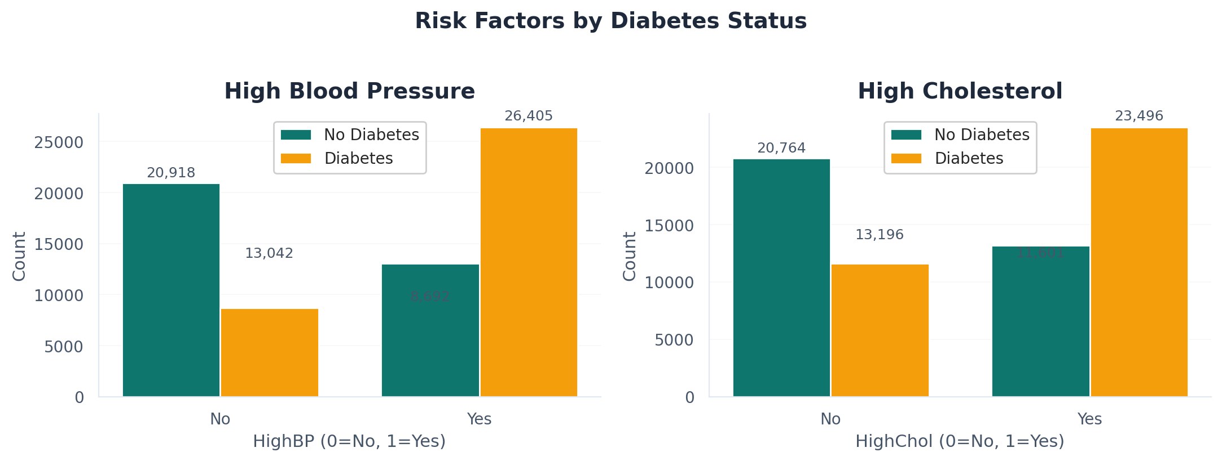
06 · EDA
Exploratory data analysis
Diabetes Risk Prediction · Intro to Data Science · Sem 2
8 / 17
Notes:
Show 4 EDA charts: class balance (perfectly 50/50), BMI distribution, BMI boxplot, and BP/Cholesterol counts. Key takeaway: diabetic patients have visibly higher BMI and more HighBP / HighChol cases.

Slide 9
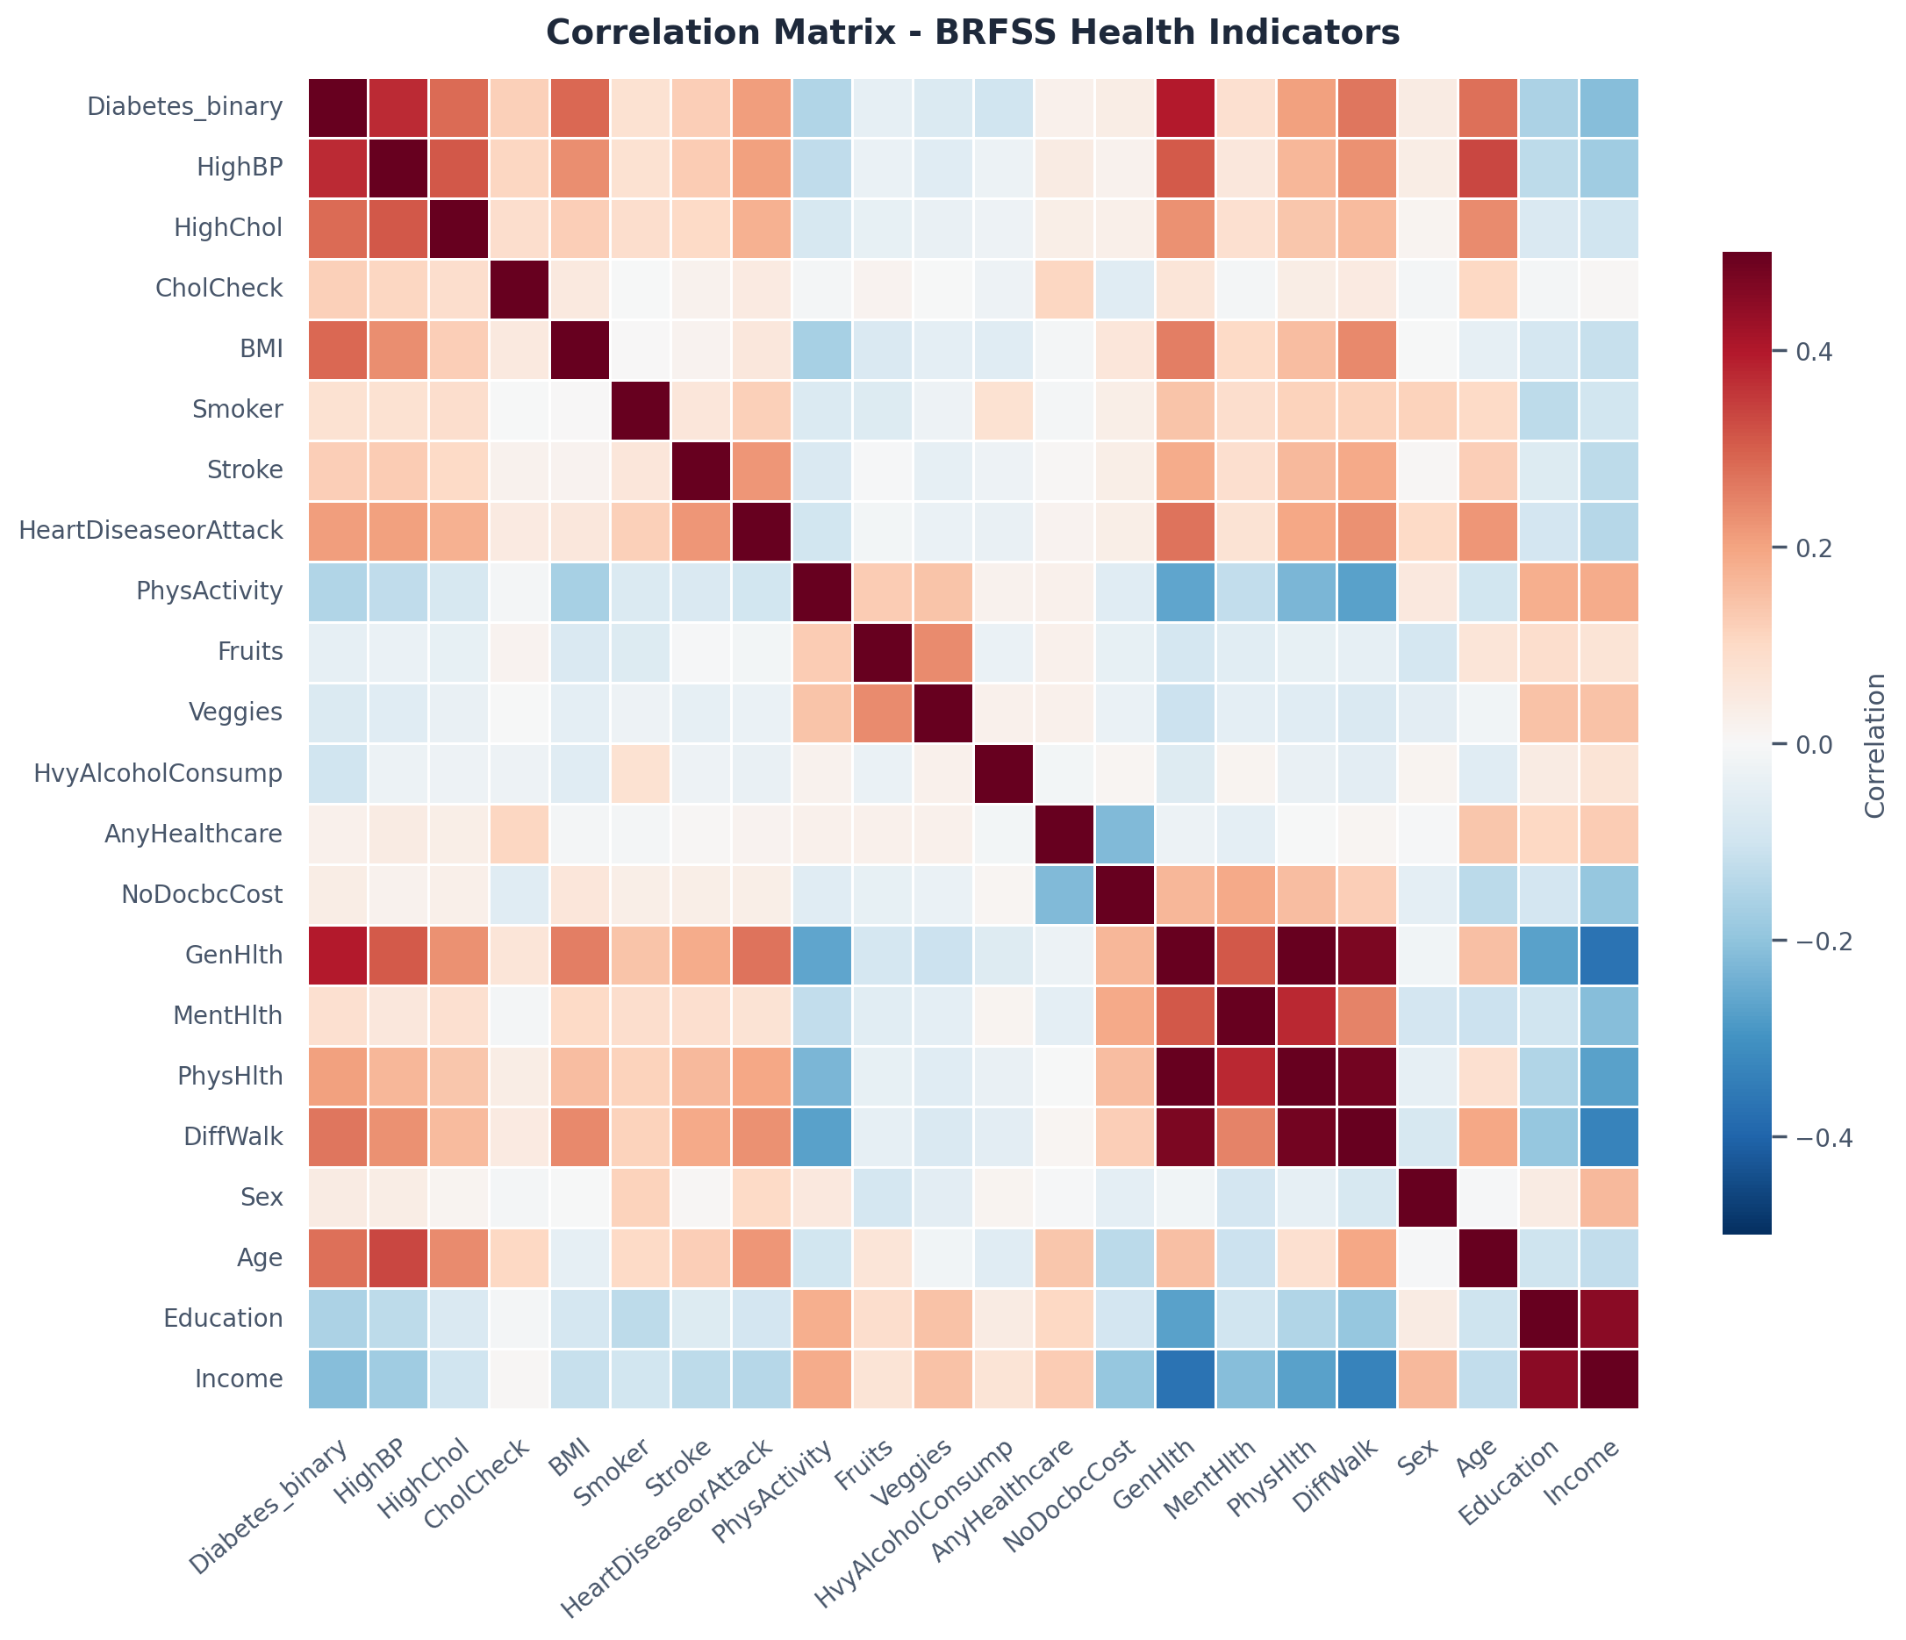
07 · CORRELATION
Which features matter most?
TOP 10 CORRELATED WITH DIABETES
GenHlth
0.40
HighBP
0.37
BMI
0.29
HighChol
0.28
Age
0.28
DiffWalk
0.27
Income
0.21
HeartDiseaseorAttack
0.21
PhysHlth
0.21
Education
0.16
Diabetes Risk Prediction · Intro to Data Science · Sem 2
9 / 17
Notes:
Heatmap shows feature relationships. The strongest correlations with diabetes are General Health (0.40), High Blood Pressure (0.37), BMI (0.29), and High Cholesterol (0.28). These are also the top features in the model — good cross-validation.

Slide 10
08 · SPLIT
Train / test split — done before everything else
DATA SPLIT
■ 80 % training data · 20 % test data
■ Stratified by target → keeps 50 / 50 balance in both splits
■ random_state = 42 → reproducible results
■ Split BEFORE any preprocessing → prevents data leakage
Train · 55 245 rows
Test · 13 812
WHY SPLIT FIRST?
If we scaled, imputed, or sampled before splitting, information from the test set would leak into training. Accuracy would look great in our notebook but fail on new data.
Diabetes Risk Prediction · Intro to Data Science · Sem 2
10 / 17
Notes:
This is the most important methodology point. Mention 'data leakage' by name — it shows mastery. Explain we split first so the test set is truly unseen.

Slide 11
09 · APPROACH
Why supervised machine learning?
LEARNING TYPE
TASK
OUTPUT
Supervised
Classification
Probability + label
The target column is labeled (0 / 1) — the model learns from known examples.
We predict a discrete class, not a number. Two classes → binary classification.
Each prediction includes a confidence score, useful for risk-screening contexts.
Diabetes Risk Prediction · Intro to Data Science · Sem 2
11 / 17
Notes:
State clearly: this is supervised binary classification. We have labeled examples, two classes, and we use the patterns to predict diabetes for new patients.

Slide 12
10 · CANDIDATES
4 supervised classifiers tested
LOGISTIC REGRESSION
DECISION TREE
Fits a probability line between the two classes
Asks yes/no questions to split the data
PROS
Simple · interpretable
PROS
Easy to visualise
CONS
Less accurate on non-linear patterns
CONS
Prone to overfitting
K-NEAREST NEIGHBORS
RANDOM FOREST
Predicts class by voting among nearest neighbours
Combines many decision trees, votes the answer
PROS
Intuitive
PROS
Robust · feature imp.
CONS
Slow on large data · needs scaling
CONS
Slower to train
Diabetes Risk Prediction · Intro to Data Science · Sem 2
12 / 17
Notes:
These are the 4 supervised classifiers we considered. We tested all four to make a data-driven choice — not just pick a favourite. RF was chosen for best F1 + feature importance for clinical interpretability.

Slide 13
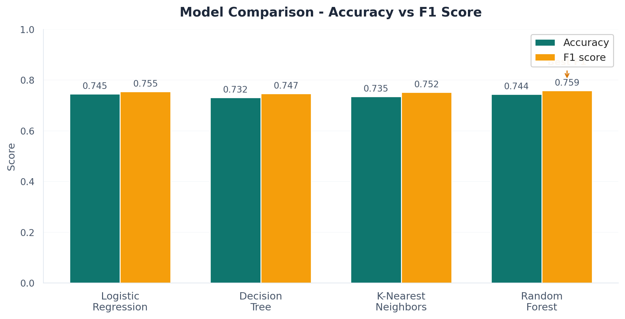
11 · RESULTS
Model comparison — real numbers
FULL METRICS
Model
Acc
F1
Logistic Regression
0.745
0.755
Decision Tree
0.732
0.747
K-Nearest Neighbors
0.735
0.752
Random Forest
0.744
0.759
WINNER
Random Forest
Best F1 (0.759) and built-in feature importance.
Diabetes Risk Prediction · Intro to Data Science · Sem 2
13 / 17
Notes:
Be honest: Logistic Regression actually has slightly higher accuracy. But Random Forest has the best F1 score AND gives us feature importance for free. F1 matters more in medical apps because we balance precision and recall. That's why we chose RF.

Slide 14
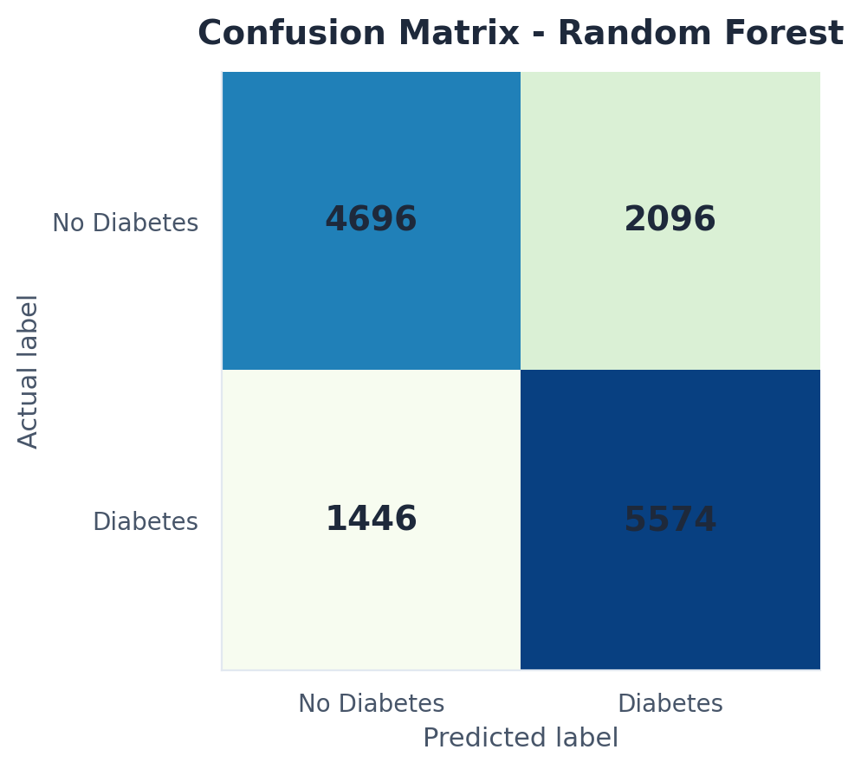
12 · FINAL MODEL
Random Forest — detailed results
ACCURACY
F1 SCORE
74.36%
0.759
PRECISION
RECALL
0.727
0.794
Predicted diabetics that were correct
Actual diabetics we correctly caught
HYPERPARAMETERS
n_estimators = 200 · max_depth = 15 · min_samples_leaf = 5
random_state = 42 · n_jobs = -1 (use all CPU cores)
Diabetes Risk Prediction · Intro to Data Science · Sem 2
14 / 17
Notes:
Confusion matrix on the left: 4 696 true negatives and 5 574 true positives. Recall of 0.79 means we caught 79% of real diabetics — this is what matters most in medical screening. False negatives are more dangerous than false positives.

Slide 15
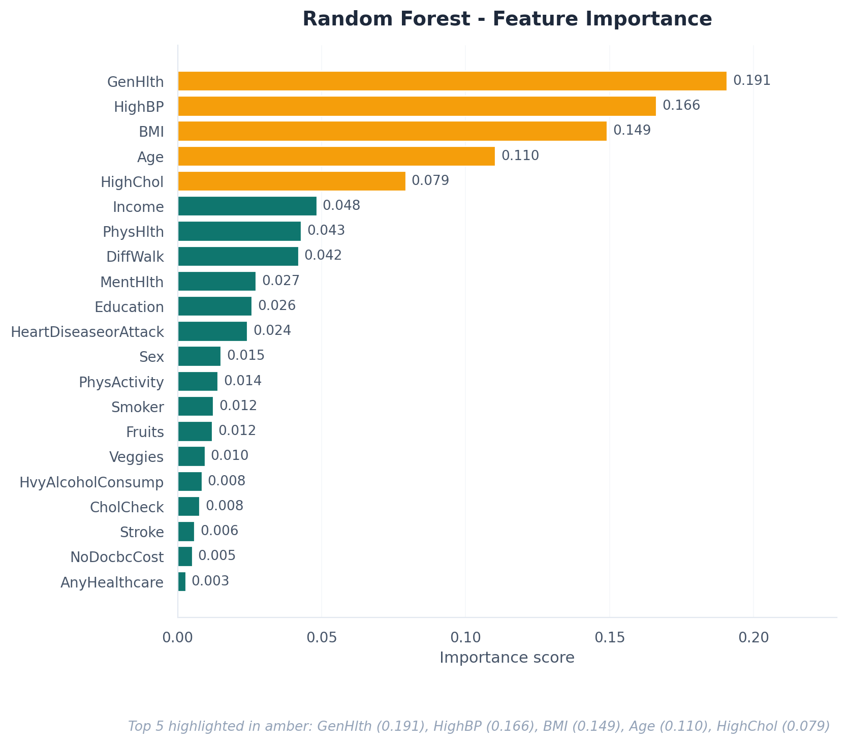
13 · INSIGHTS
Top diabetes risk factors
TOP 5 RISK FACTORS LEARNED
1.
GenHlth
importance = 0.191
2.
HighBP
importance = 0.166
3.
BMI
importance = 0.149
4.
Age
importance = 0.110
5.
HighChol
importance = 0.079
Diabetes Risk Prediction · Intro to Data Science · Sem 2
15 / 17
Notes:
The model identified the 5 most important risk factors entirely from data: General Health, High BP, BMI, Age, and High Cholesterol. These match what doctors would tell you — validating that the model learned something meaningful.

Slide 16
14 · DEPLOYMENT
Streamlit web application
■ Interactive form built with Streamlit (Python web framework).
■ User enters 21 health indicators in plain English.
■ Trained model loaded once and cached for speed.
■ Output: risk label + probability + confidence bar.
■ Code on GitHub · deployed free on Streamlit Cloud.
DIABETES RISK PREDICTION
BMI
27
High BP
Yes
High Chol
No
General Hlth
3 - Good
Age group
50-54
PREDICT
HIGH RISK
probability 68 %
Diabetes Risk Prediction · Intro to Data Science · Sem 2
16 / 17
Notes:
Show or describe the live app. If on Streamlit Cloud, show the URL. The app loads the trained model and lets anyone enter data to get an instant prediction. Mention this is your 'demo moment' if you can run it live.

Slide 17
15 · WRAP-UP
Limitations · Conclusion · Q&A
LIMITATIONS
LIKELY QUESTIONS
· Self-reported survey data is noisy.
· No lab values (no HbA1c or glucose).
· Balanced data ≠ real-world prevalence (~14%).
· Class 1 mixes diabetic + prediabetic.
Why Random Forest over Logistic Reg?
Best F1 + feature importance for free.
Why only 74% accuracy?
Self-reported data caps it; matches published research.
Why drop duplicates?
Prevents test-set inflation (data leakage).
Supervised or unsupervised?
CONCLUSION
Supervised - target is labeled 0 / 1.
· Random Forest classifier · 74.4% test accuracy · 0.759 F1 score.
· Identified 5 dominant risk factors aligned with medical literature.
· Delivered a working web app and reproducible notebook.
How would you improve it?
Add lab values · try XGBoost · tune hyperparameters.
Thank you ·
Diabetes Risk Prediction · Intro to Data Science · Sem 2
17 / 17
Notes:
Close with humility (limitations) then confidence (conclusion). The Q&A panel preemptively answers the most common questions. Always end with 'Thank you — any questions?'

